Slide 1
The Internet and Encryption
By Brendan Copp

Slide 2
What is Encryption
What is it
Encryption is the act of securing ones data
Different types of encryption
HTTP vs HTTPS
SSH Keys
PGP
Why is this Important
Send sensitive data over an unsecured network

Slide 3
HTTP
Http is a network protocol which sends data over the internet in Plaintext.
Why is plaintext not secure?
Plaintext can be openly read by anyone on an unsecured network through the use of packet analysis
HTTPS encrypts this plain text so it is unreadable by a third party

Slide 4
HTTPS
HTTPS uses SSL protocols .
'asymmetric' Public Key Infrastructure (PKI) system.
An asymmetric system uses two 'keys' to encrypt communications, a 'public' key and a 'private' key.
Anything encrypted with the public key can only be decrypted by the private key and vice-versa.

Slide 5
Correct usage
Private' keys should be kept strictly protected and should only be accessible the owner of the private key.
Public key is intended to be distributed to anybody and everybody.

Slide 6
Short Example of PGP
PGP stands for pretty good privacy
It uses the same symmetric key cryptography that HTTPS
Is allows a user to encrypt a personal data using another users public key and send the secured information over an unsecured network.
Beware of who you are sending your personal information to!

Slide 7
VIDEO
https://www.youtube.com/watch?v=dut9EnbFym0
1:45 – 2:50

Slide 8
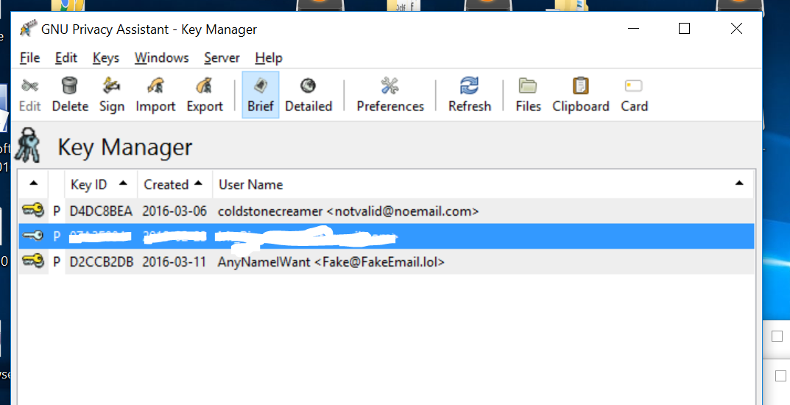
Now Lets Encrypt a Message!
- 2 Private keys owned by me

Slide 9
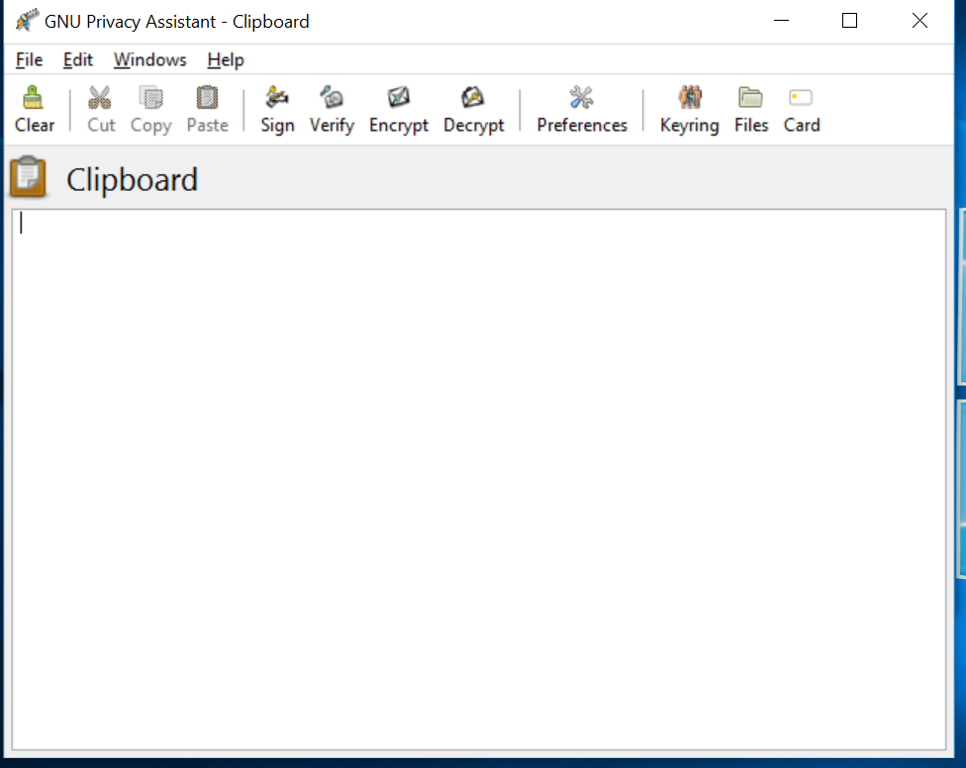
Creating a message
- Empty Plain text clipboard

Slide 10
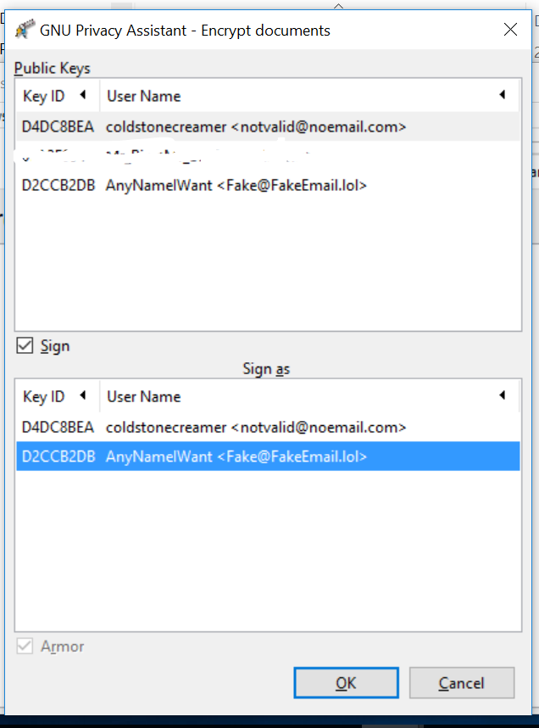
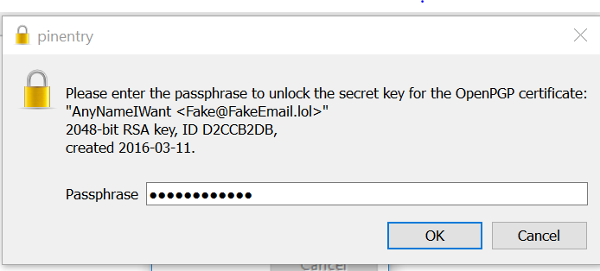
Encryption Process
Encryption ,
Validation,
and virtual signature

Slide 11
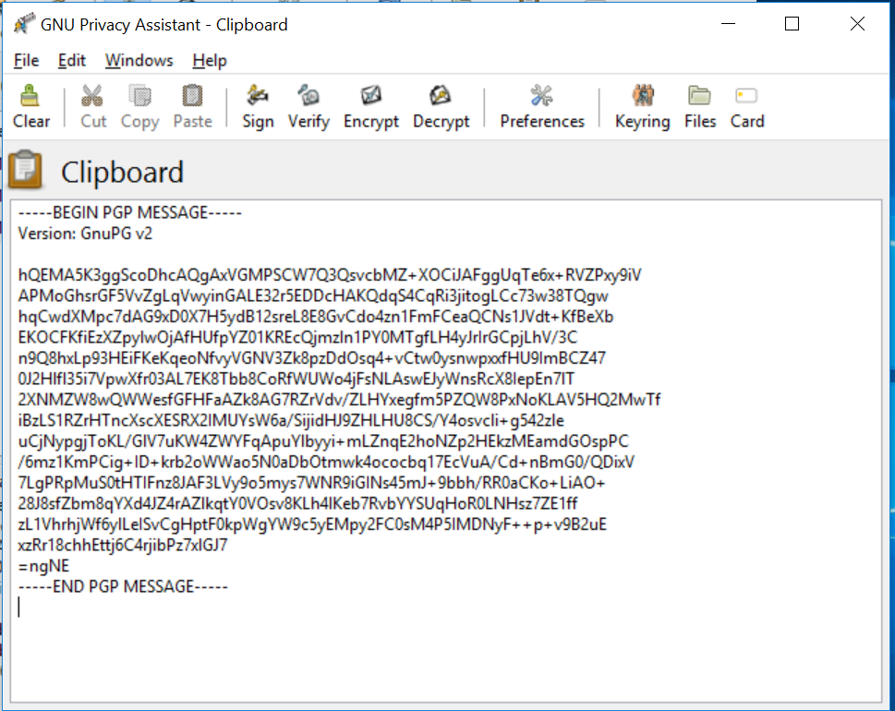
Encrypted Message

Slide 12
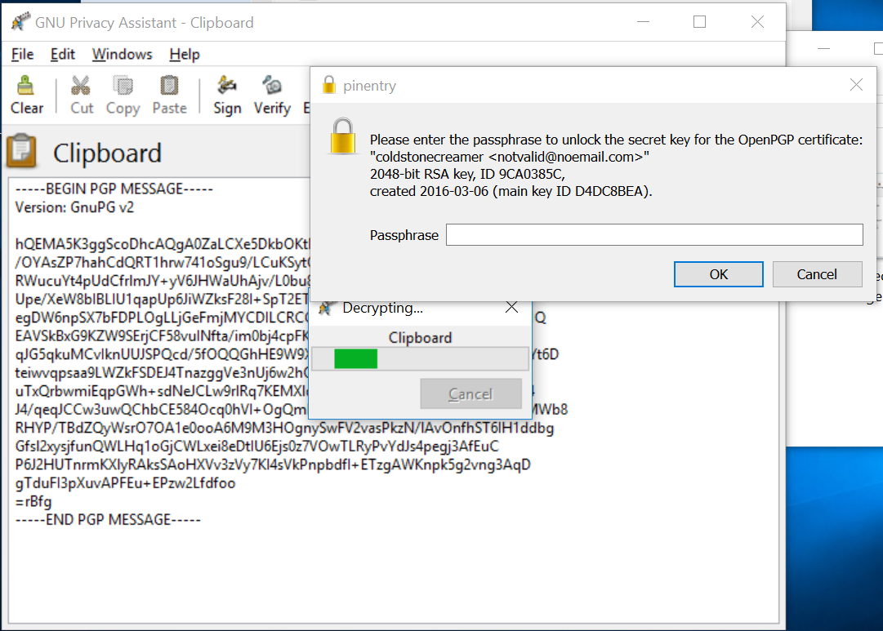
Decrypting the Message

Slide 13

The Decrypted Message

Slide 14
What does HTTPS not secure
HTTPS uses underlying HTTP protocol data such as the URL request (which particular web page was requested), query parameters, headers, and cookies (which often contain identity information about the user) can be seen. “However, because host (website) addresses and port numbers are necessarily part of the underlying TCP/IP protocols, HTTPS cannot protect their disclosure. ”

Slide 15
How can Encryption be bad
Encryption can be used by criminals
They could send vital information regarding drugs, services, people
PGP Key encryption has been used by ISIS & Cartel
PGP is used on the Darknet
Prevents the government from reading potentially dangerous messages

Slide 16
Ethical Questions
What do you think of encryption?
Major Controversies
We can agree that is must be used to some existent on the web
Could it be a hazard to homeland security
Should people be allowed to send absolute secure data to another person?
Should the government require a backdoor into encryption applications?
Is it necessary?

Slide 17
Thank You

Slide 18
Sources
https://en.wikipedia.org/wiki/Pretty_Good_Privacy
http://news.softpedia.com/news/Dyre-Trojan-Uses-Its-Own-SSL-Certificate-to-Communicate-with-Control-Server-460224.shtml
https://en.wikipedia.org/wiki/Man-in-the-middle_attack
http://www.biztechmagazine.com/article/2007/07/http-vs-https
https://www.instantssl.com/ssl-certificate-products/https.html

